Slide 1

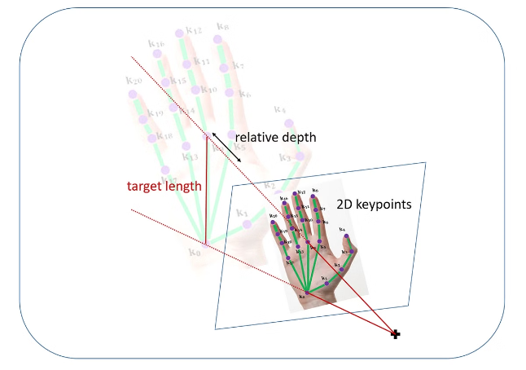

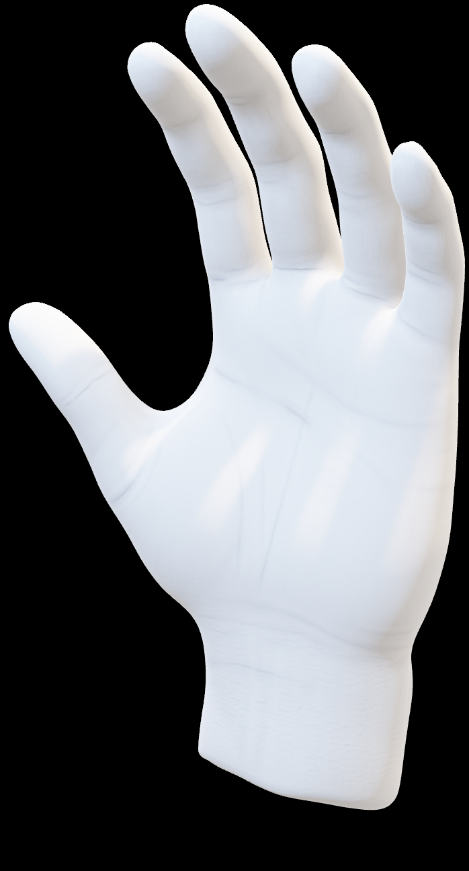
Introduction to Handtracking with Mediapipe
Mediapipe is a powerful open-source framework that enables efficient and accurate handtracking. This introductory section provides an overview of the key concepts and applications of handtracking using Mediapipe.
by sushant sahu

Slide 2


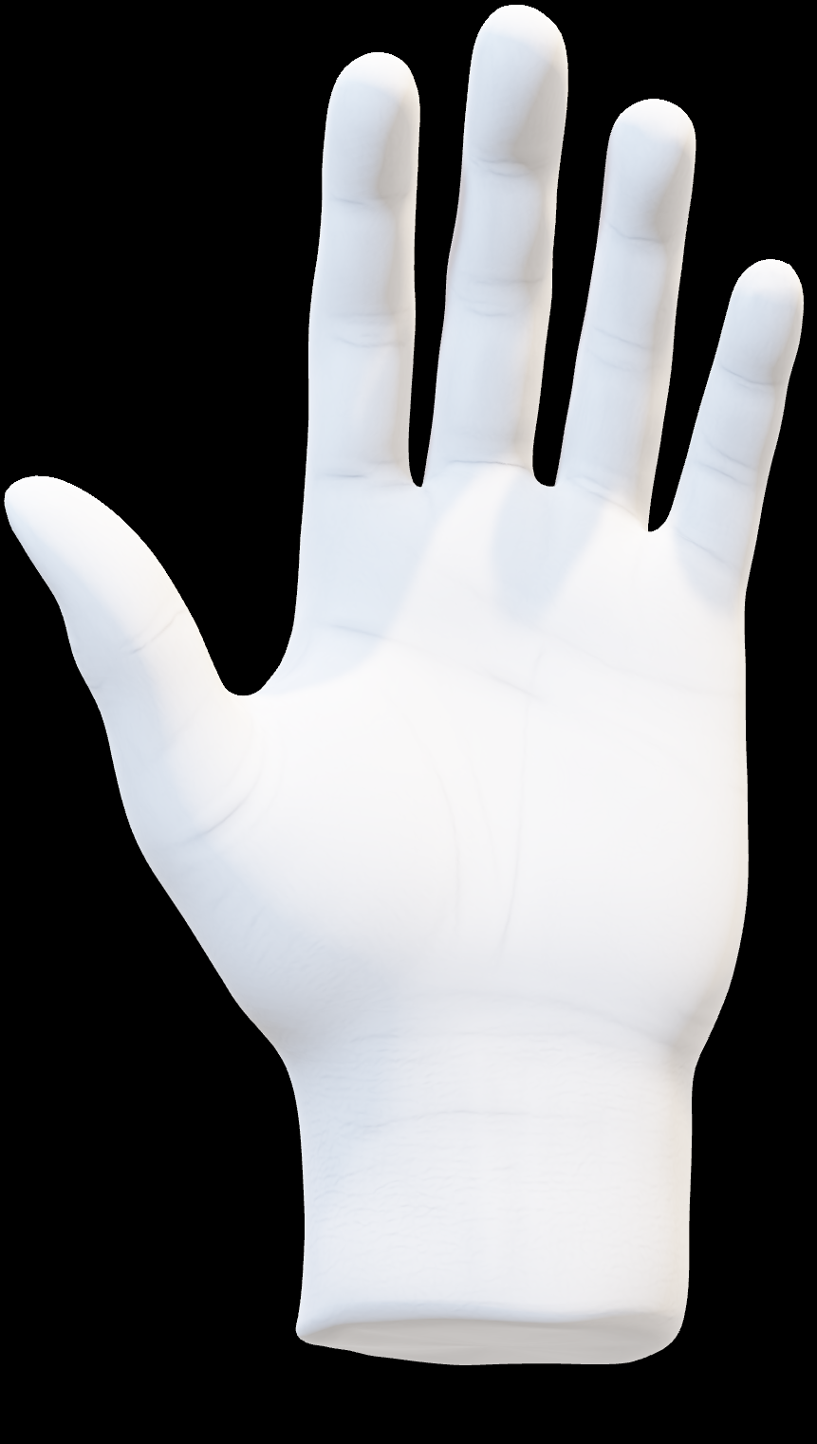
What is Mediapipe?
1
Modular ML Pipeline
2
Cross-Platform
Mediapipe is a flexible, customizable machine learning pipeline that simplifies the development of complex vision and audio applications.
Mediapipe's models can be deployed on a variety of platforms, from mobile devices to the cloud, enabling ubiquitous handtracking experiences.
3
Open-Source
Mediapipe is an open-source project, allowing developers to contribute, customize, and extend its capabilities.

Slide 3
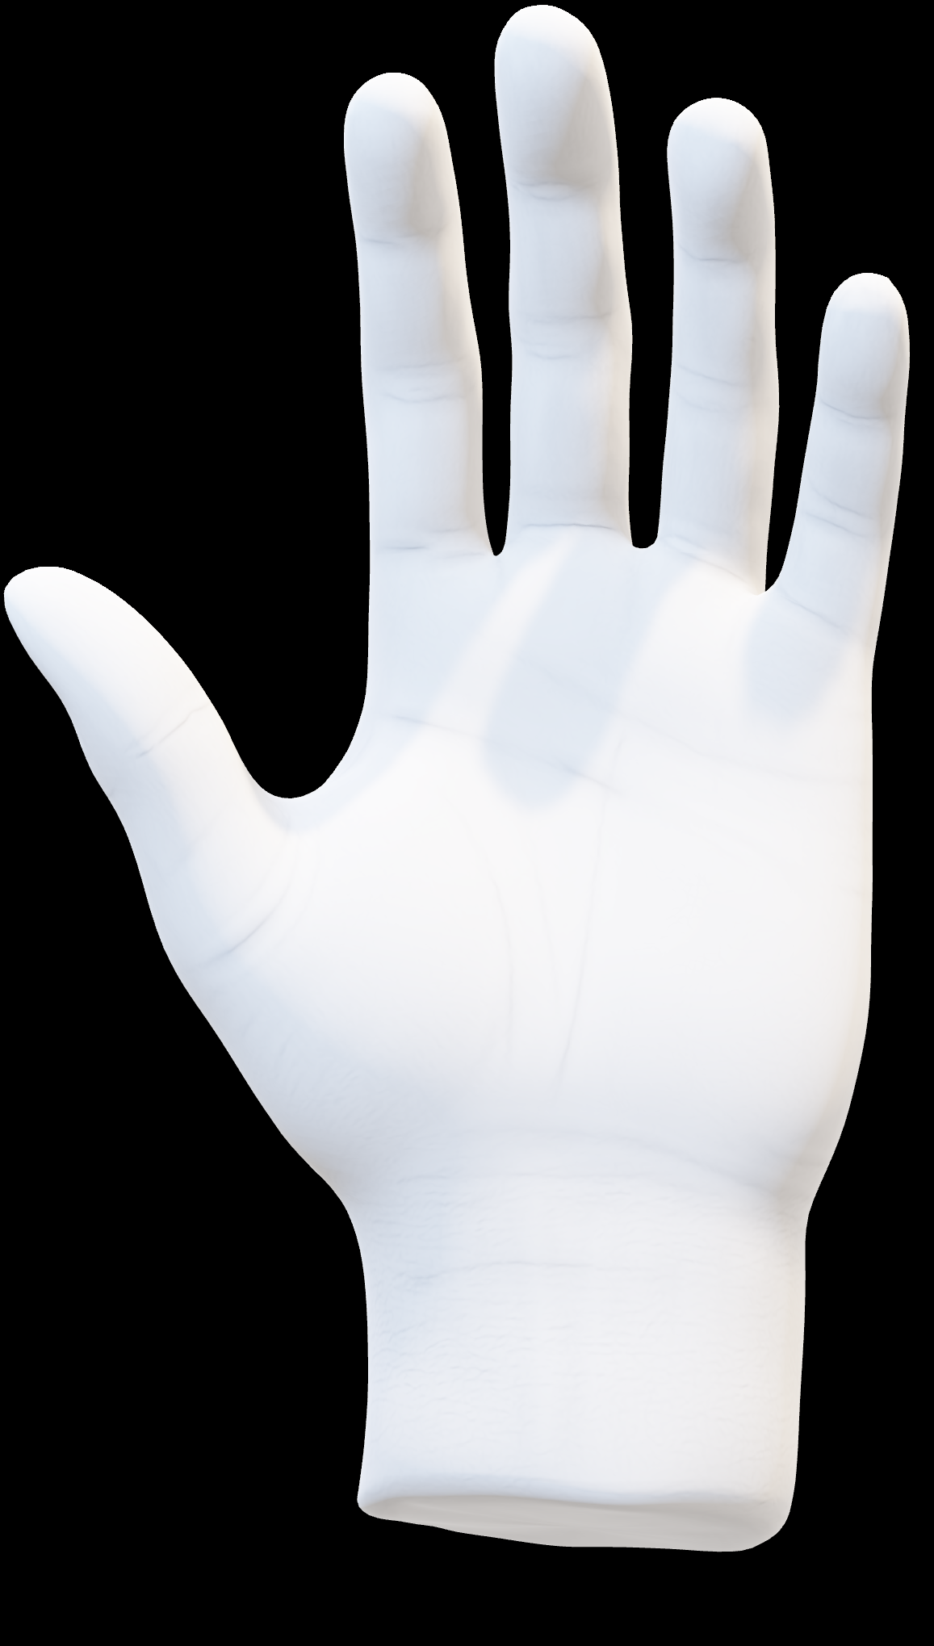
Handtracking Fundamentals
Hand Anatomy
Coordinate Systems
Depth Perception
Understanding the complex structure of the human hand, including bones, joints, and muscles, is crucial for accurate handtracking.
Mediapipe uses a 3D coordinate system to precisely locate and track the position of the hand and its landmarks.
Depth information is essential for distinguishing fingers and accurately tracking hand movements in 3D space.

Slide 4


Slide 5

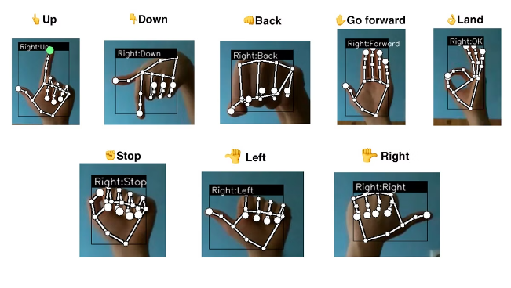
Mediapipe Handtracking Pipeline
1
Input Capture
The pipeline begins by capturing video or image data from a camera or other input source.
2
Hand Detection
Mediapipe's hand detection model identifies the presence and location of hands within the input data.
3
Landmark Extraction
The hand landmark model then precisely locates and tracks the 21 key points (landmarks) on each detected hand.

Slide 6


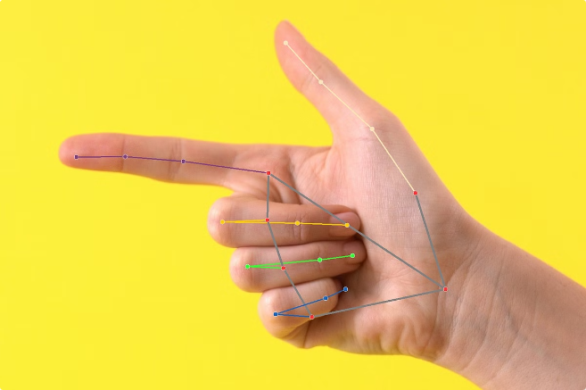


Landmark Detection and Tracking
Palm
Mediapipe precisely tracks the center and orientation of the palm.
Fingers
Each of the 5 fingers is tracked, including the tip, middle, and base of each finger.
Wrist
The position and orientation of the wrist are also detected and tracked.

Slide 7
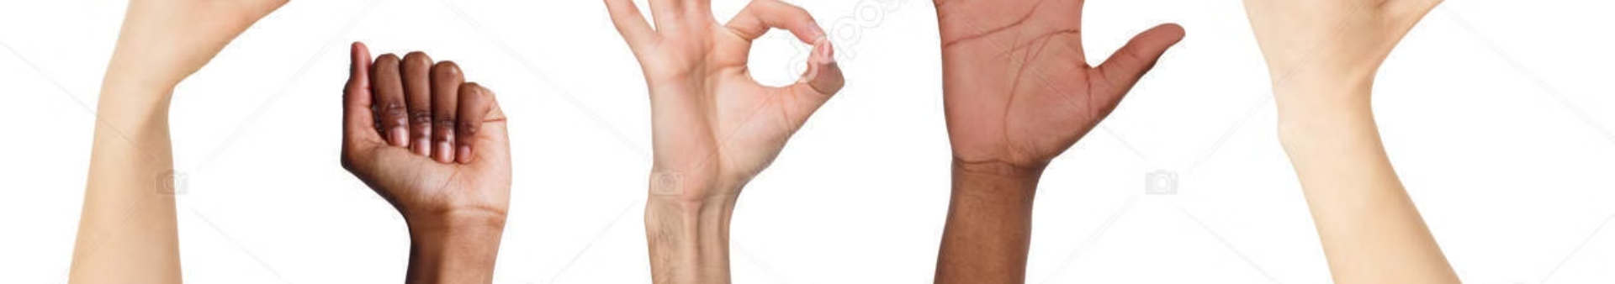
Gesture Recognition
Static Gestures
Dynamic Gestures
Mediapipe can recognize specific hand poses, such as a fist, open palm, or pinched fingers.
The framework can also detect and interpret more complex hand movements and gestures, enabling natural user interactions.
Customizable
Real-Time
Developers can train Mediapipe to recognize custom gestures tailored to their application's needs.
Mediapipe's fast processing allows for seamless, real-time gesture recognition in interactive applications.

Slide 8

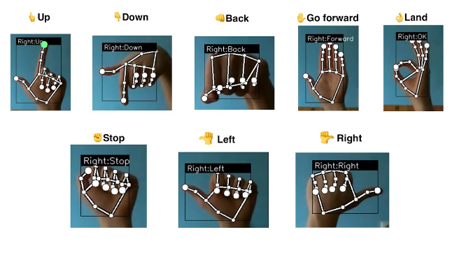


Applications of Handtracking
User Interfaces
Handtracking enables natural, intuitive interactions with digital interfaces, such as virtual buttons, sliders, and gestures.
Augmented Reality
Mediapipe's precise hand tracking supports AR experiences that allow users to manipulate virtual objects with their hands.
Sign Language Recognition
The technology can be used to interpret sign language, enabling improved communication and accessibility.

Slide 9

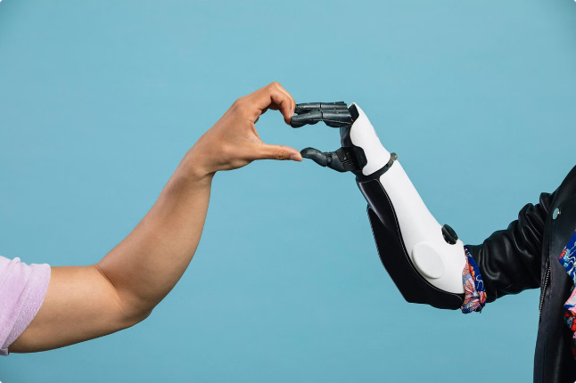
Conclusion and Future Developments
Mediapipe's Handtracking
Advancing Capabilities
Accurate real-time tracking
Improved gesture recognition
Cross-platform deployment
Integrated with other AI models
Open-source, customizable
Expanded device compatibility
As Mediapipe continues to evolve, the future of handtracking promises increasingly natural and intuitive human-computer interactions across a wide range of applications.

